Slide 1
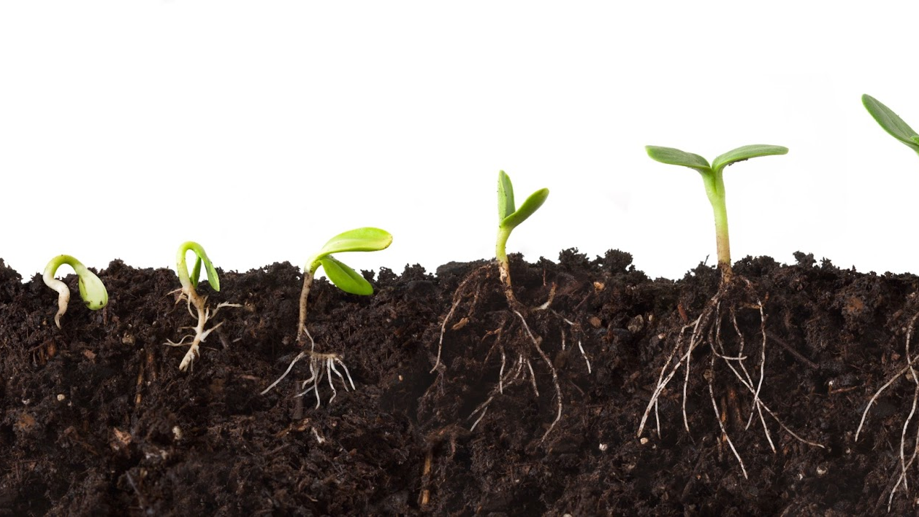
SIMULATING PLANT GROWTH: MODELING VARIABLES AFFECTING THE SPEED & QUALITY OF PROPAGATION
RYAN GOSS & POURNA SENGUPTA

Slide 2
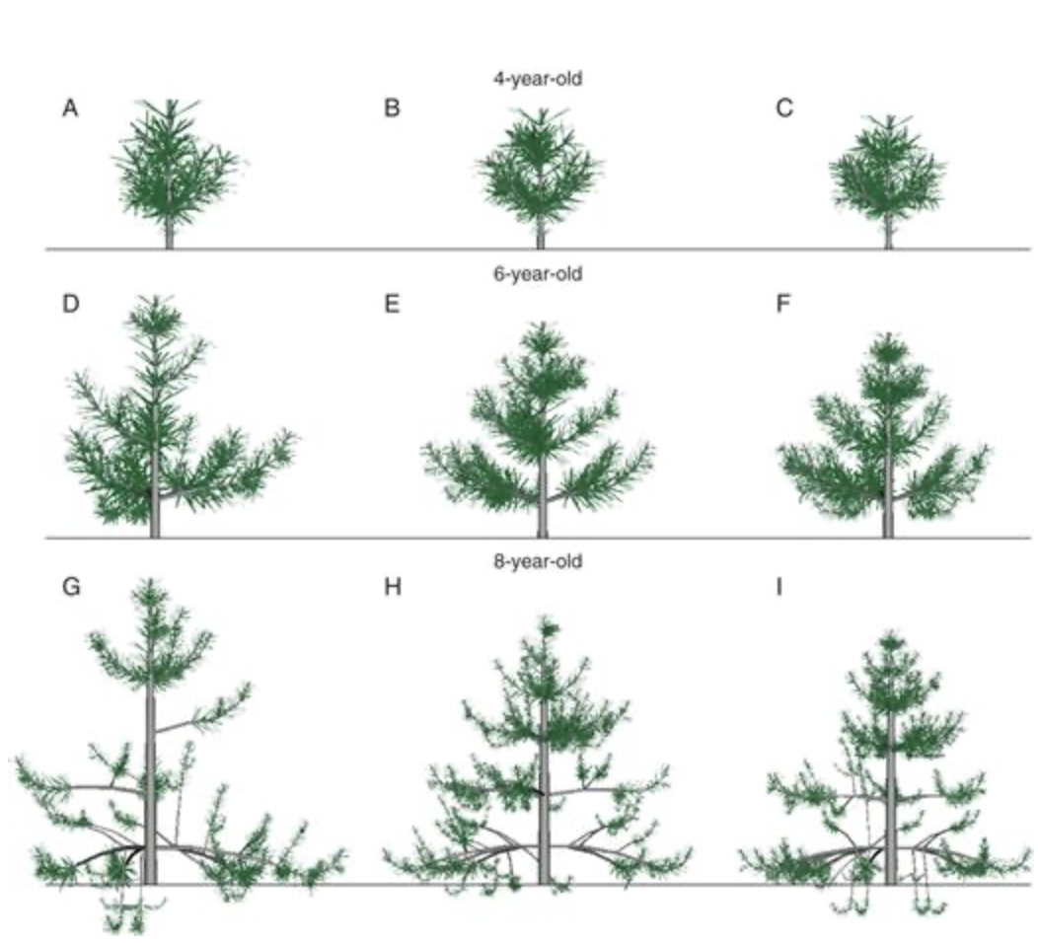
B A C K G R O U N D
impact of environmental conditions on plant growth
small scale “greenhouse” or “garden”
factors
sunlight
water
nutrients/soil
further considerations
elevation
surrounding environment
temperature
how does varied environmental factors affect plant growth and behavior?
Notes:
Speaker Notes:
Our project aimed to simulate the impacts of varied growing conditions on plant growth in an area. Plant growth itself proved to be a complex process with diverse topics to research.
Computer Science allows for function, structural and architectural modeling of individual plant species, growth in large areas with varying conditions, and shows applications in climate change and environmental predictions.
We set out to model a relatively small scale “greenhouse” or “garden” with interacting plants exposed to varied conditions of sunlight, water, and soil nutrients. Compared to our original plan of rudimentary structural modeling, our current model will include natural impacts such as water runoff due to elevation or decreased light due to surrounding plant or object heights.
Our simulation aims to answer the question: How does varied environmental factors affect plant growth and behavior?

Slide 3
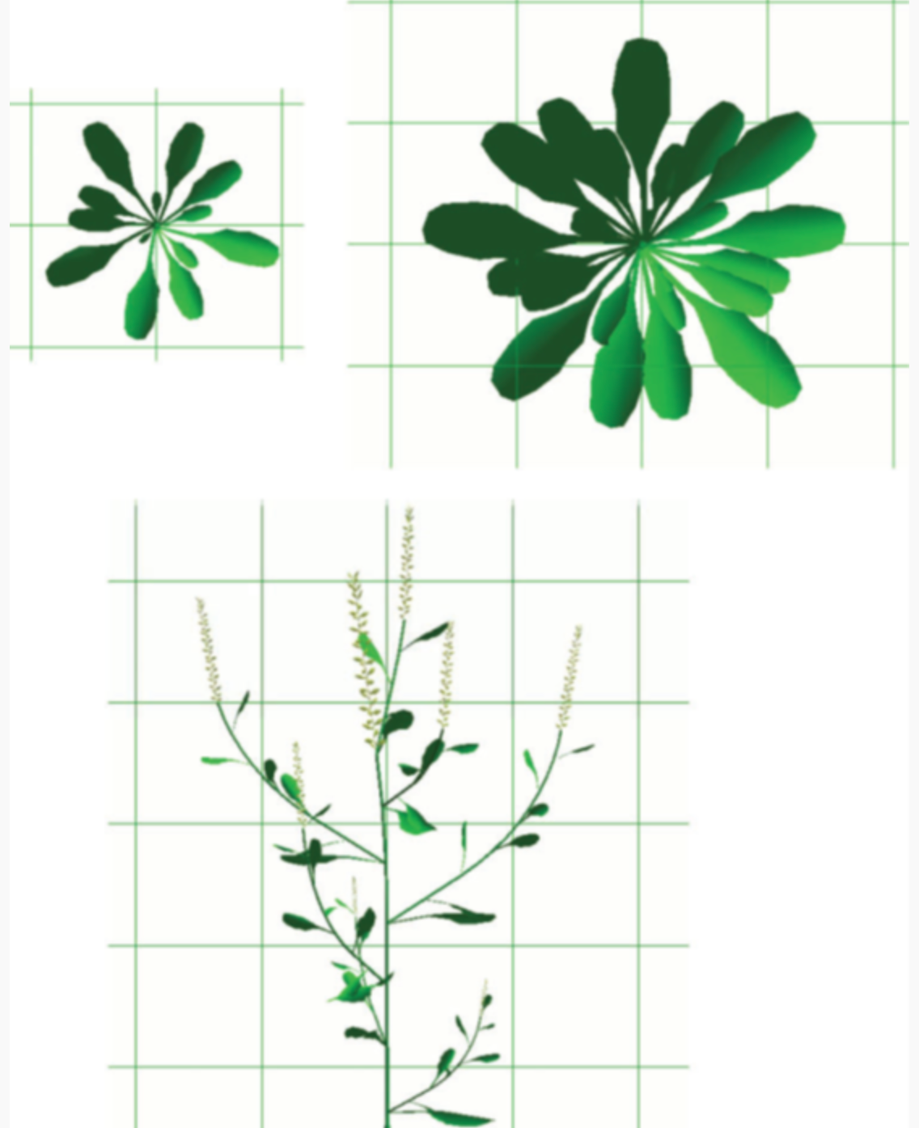


P R E V I O U S W O R K
architectural plant modeling
Atelier de Modelisationde 1’Architecture des Plantes (AMAP) 1980
GreenLab
model plants under varying conditions
Notes:
Architectural plant modeling as a confluence between biology, mathematics, computer science has been evolving for the past two to three decades.
One of the first such incarnations start with a software called Atelier de Modelisationde 1’Architecture des Plantes (AMAP) (~1980)
A rudimentary application for randomly generating growth of various plants via some pre-programmed template controls
Recently been updated in the form of GreenLab

Slide 4
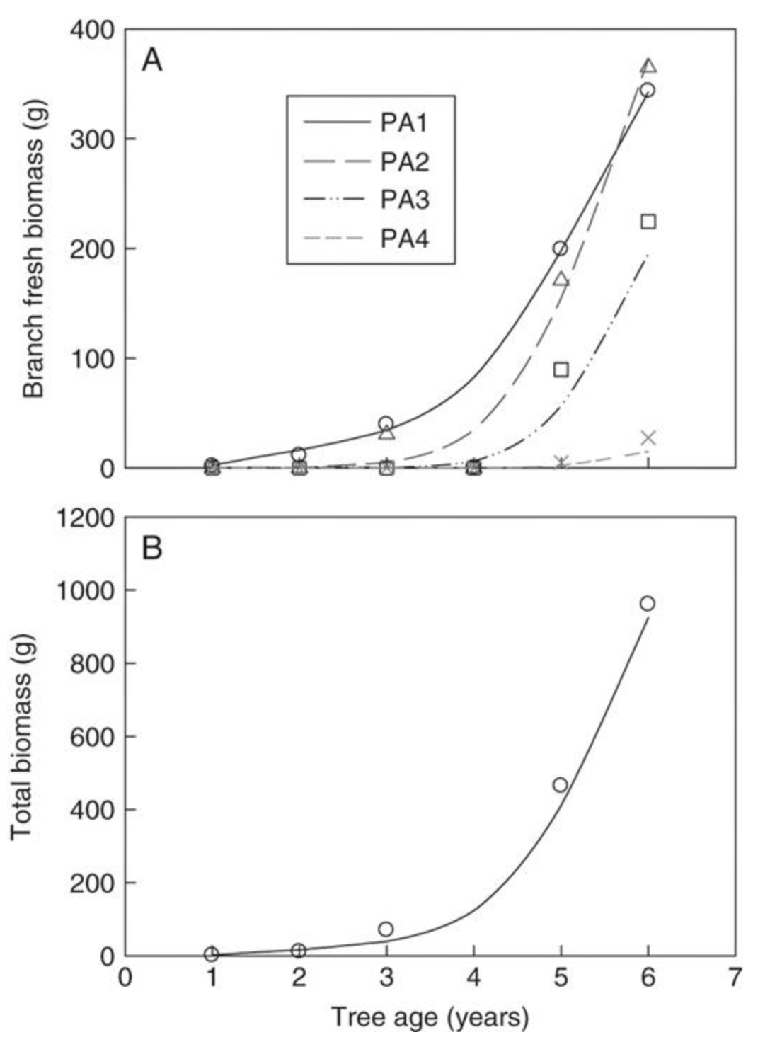
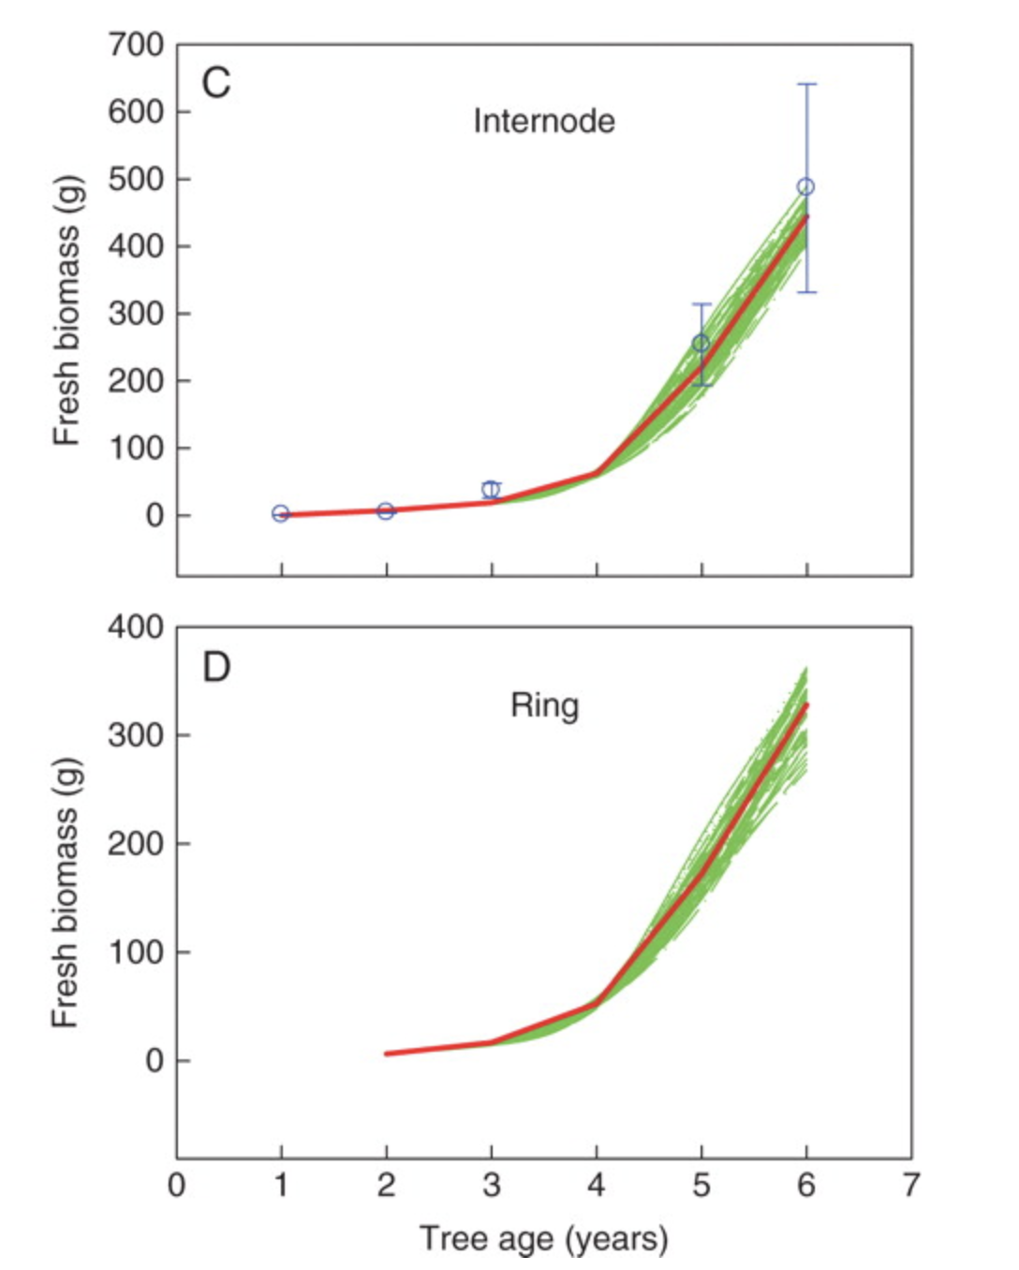
g r e e n l a b MONGOLIAN SCOTS PINE SPECIES
successful simulation of deterministic topologic development in native habitat
stochastic functional-structural model (GL2)
(Wang et al. 2011)
Notes:
GreenLab is generally considered one of the gold standards for modeling plant architectural growth over time
Can be modified to model a number of different plants under varying conditions
E.g. - One such publication reported a successful simulation of deterministic topological development of a Mongolian Scots pine species in its native habitat (Wang et al. 2011)
Utilized a stochastic functional–structural model (GL2)

Slide 5
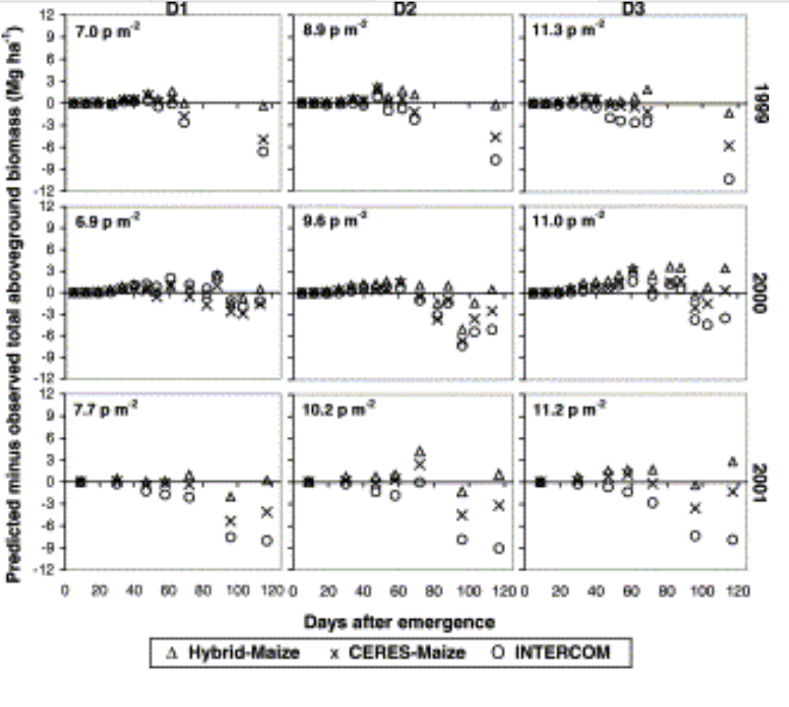
C R O P B I O M A S S M O D E L S
maize crop modeling
CERES generic crop model
INTERCOM crop specific model
hybrid maize model
combined strengths
Predicted vs. Actual Biomass
(Dobermann et al. 2004)
Notes:
From the perspective of larger scale, crop biomass modeling is a large and intense area of research
One such exploration leveraged two different model approaches to maize crop modeling (Dobermann et al. 2004)
“Generic crop model” - CERES, which simulates photosynthesis and respiration from available environmental assimilates
“Crop specific model” - INTERCOM, which simulates specific phenotypic plant organ growth stages
Combined strengths of both models for a “Hybrid Miaze” Model
Indicated close agreement between simulated and measured values for leaf area, dry matter accumulation, final grain and stover yields, and harvest index (HI)

Slide 6
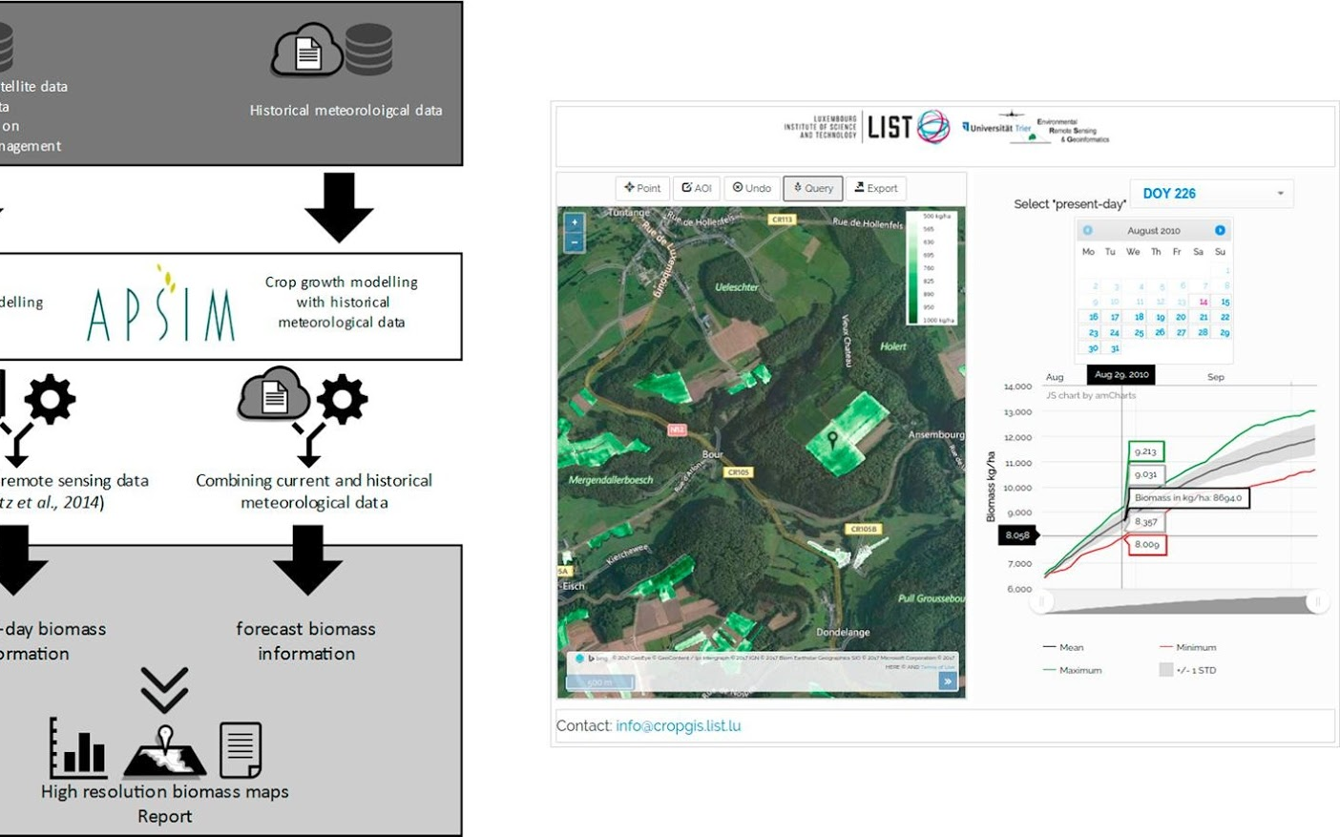
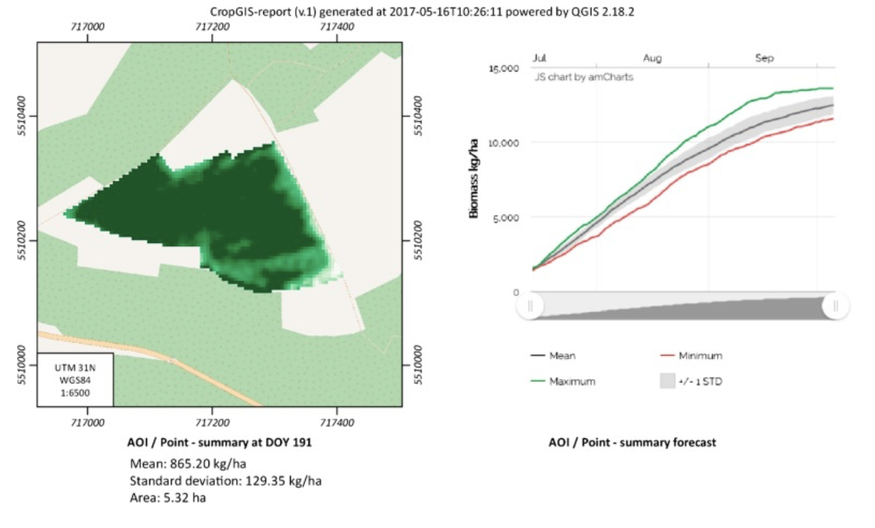
MODELING BIOMASS SPATIAL GROWTH
crops, forest, gardens, etc.
geo-spatial satellite data + crop growth model (CGM) + agricultural growth simulator
using meteorological data
simulate and predict biomass spatial growth across wide area
(Machwitz, 2019)
Notes:
While GreenLab is highly plant architecturally focused, there is a wide array of published work in modeling crop or broad plant-life growth
E.g. one such publication utilized a geo-spatial satellite data along with a crop growth model (CGM) and agricultural growth simulator from meteorological data (Machwitz 2019)
Used to simulate and predict biomass spatial growth across a wide area.

Slide 7
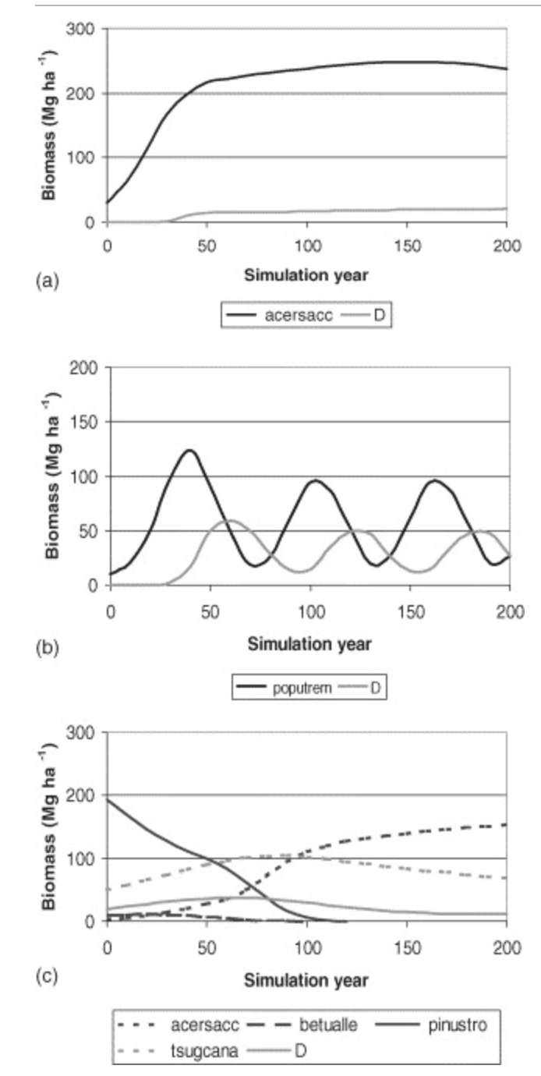
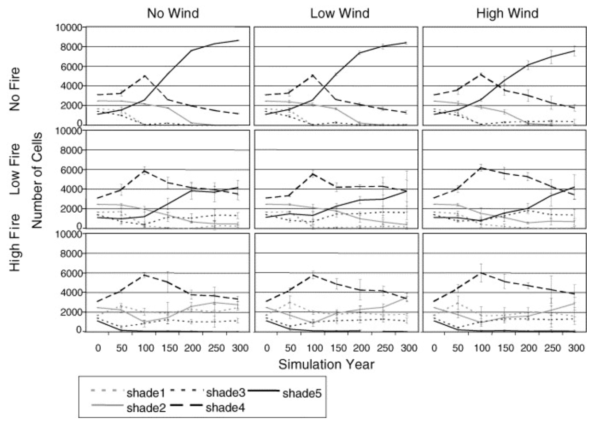
MODELING FOREST GROWTH
biomass growth,
mortality, & decay
LANDIS spatially dynamic landscape simulation model
disturbances, dispersal, competition
simulation of artificial landscape representative of northern wisconsin
Notes:
Another publication focused on biomass of forest growth, modeling biomass growth, mortality, and decay into LANDIS, a spatially dynamic landscape simulation model
The model simulates disturbances (fire, wind, harvesting), dispersal, forest biomass growth and mortality, and inter- and intra-specific competition.
Quantified how fire and windthrow alter forest succession, living biomass and dead biomass across an artificial landscape representative of northern Wisconsin, USA

Slide 8

















A P P R O A C H
PARAMETERS
CONDITIONS
greenhouse/garden
3 or more species
interactions (distance/spacing)
CONSIDERATIONS
Notes:
Develop a virtual greenhouse / garden, which simulates the growth of at least 3 different plant species.
Each, with unique intake parameters: water, sunlight, nutrients
Distance/spacing interactions
With this model, understand how each of these simulated virtual plants grows under a variety of conditions:
Low light or limited intense light
Water elevation dispersal, runoff
Competition for low nutrient resources

Slide 9
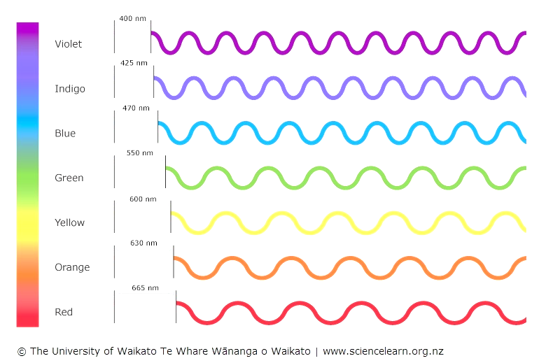
M E T H O D S
&
C U R R E N T P R O G R E S S
greenhouse class
call & grow simulated plants (circles)
grid initialized to determine plant location
perform_timestep & grow_plant
irrigate & add sunlight
unique parameters
Notes:
Create a greenhouse class to call and grow simulated plants (indicated by growing circles).
Grid of landscape initialized to determine plant locations
Perform_timestep, grow_plant functions
Irrigate, add sunlight functions
Each plant with unique parameters:
Color, light requirement, sun requirement

Slide 10
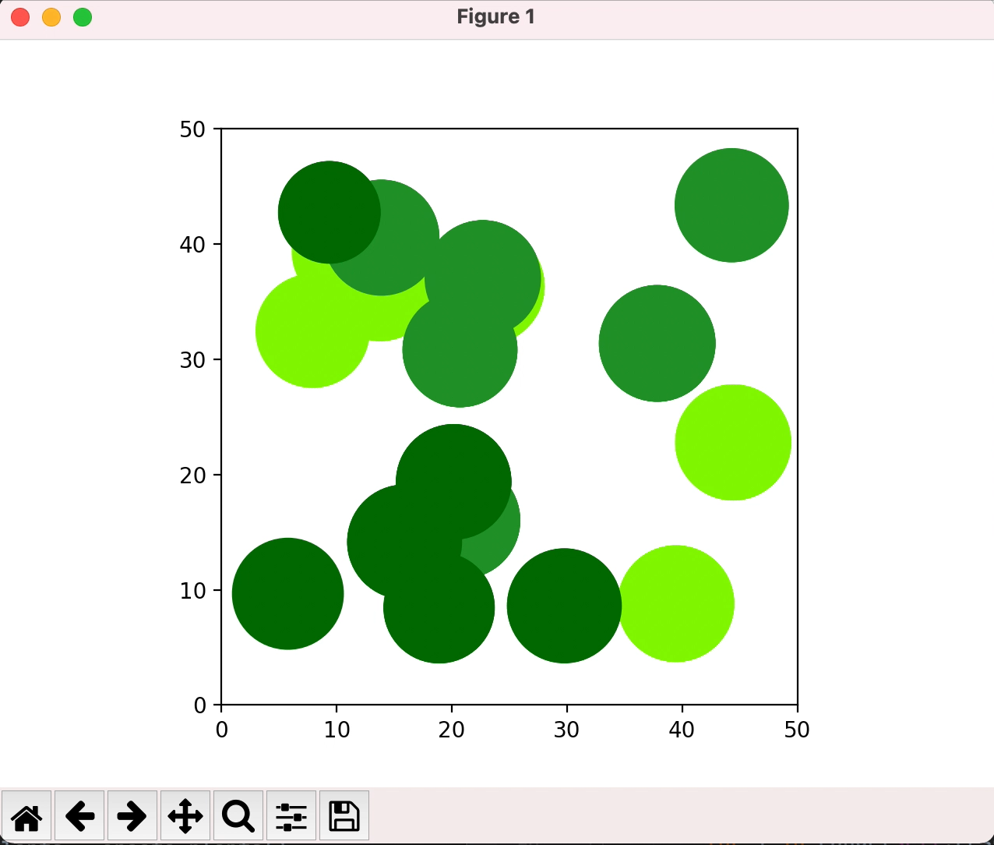
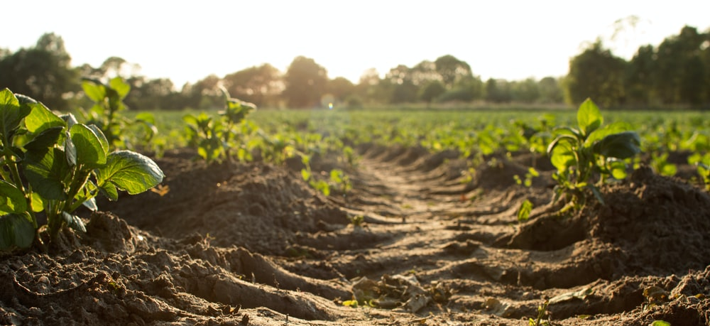
CONSIDERATIONS
Notes:
Current simulation randomizes the location of plants and begins grow cycle.
Currently, spatial, sunlight and water requirements not fully complete/working

Slide 11
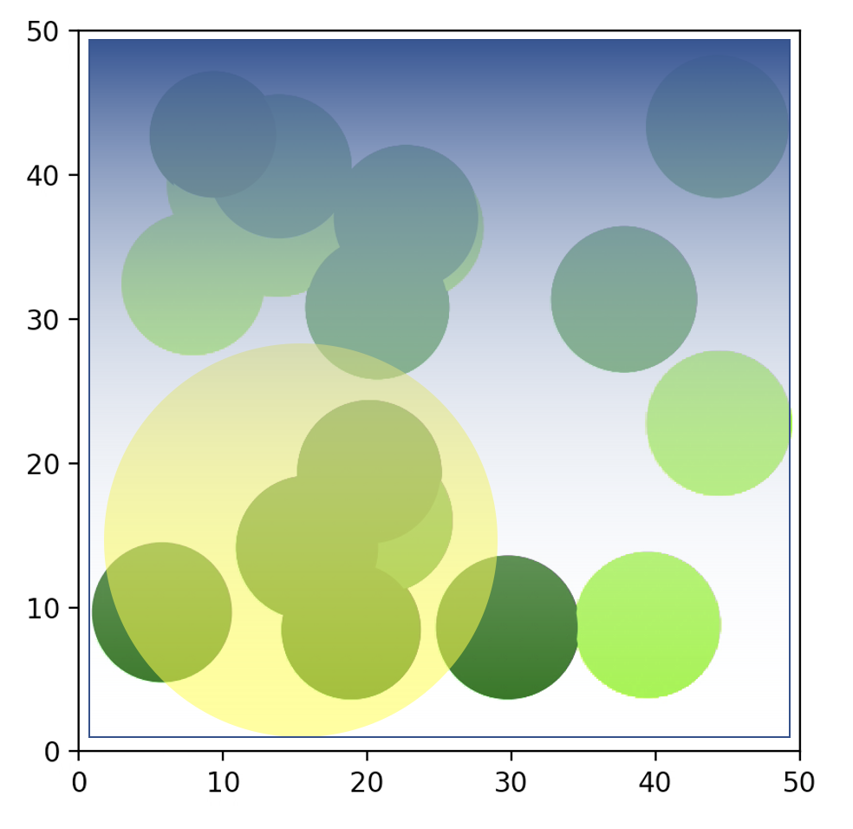
N E X T S T E P S
visualize resources as heat map
impact of resources & conditions
simulate variety of combinations
predict growth patterns over time
Notes:
The goal is to visualize resources (e.g., light, water) in the form of a heat map to see how the plant growth will react/accumulate in these areas
Run simulations of:
Low light or limited intense light
Water elevation dispersal, runoff
Competition for low nutrient resources
Determine if a somewhat realistic simulation/model can be developed to predict growth patterns over time.

Slide 12
C O N C L U S I O N
further progress on model
predicting growth patterns of competing plants with varied resources and conditions
further research
experimental data of greenhouse plant growth
create parameters matching experimental data
implement machine learning for best resource & condition determination
Notes:
Framework in place, still further progress to be made on model.
Future application of model to predict growth patterns of competing plants for resources under varying conditions
Future research:
Collect experimental data of plant growth in greenhouses from imaging over time
Utilize data to create parameters that match those used in the greenhouse
Machine learning techniques could be applied to determine best parameters / values.

Slide 13
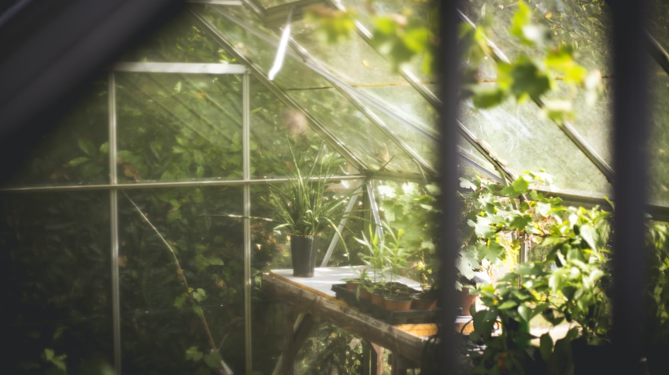
t h a n k y o u

